Slide 1

Umbrella Coin
A Democratized, Decentralized Insurance Platform

Slide 2
Traditional Insurance
Policyholder pays monthly premium in category based on risk
Insurance company takes premiums and invests in commodities
100B USD profit for US Insurance companies in 2014
Insurance between 8-9% of GDP for OECD countries (https://data.oecd.org/insurance/insurance-spending.htm)
Filing claims frequently raises premiums, causing reluctance to file
Policyholder required to pay out of pocket deductible for many claims
Insurance will not cover claims that do not meet policy deductible
Companies have high overhead of paperwork and processing that makes it cost prohibitive to cover smaller claims

Slide 3
Umbrella Coin
Made to complement traditional insurance
Hidden costs like deductibles, co-insurance, co-pays, or uncovered claims
UMC is not insurance
Built on Ethereum Blockchain
Allows for decentralized system of policy holders to control distribution and assessment
Lowers traditional overhead of processing claims
Allows users to create policies and claims via a web client
Limit maximum payouts initially to avoid crippling policies
Policyholders incentivized to vote on others’ claims
Income generated via policy creation, early policy cancelation and penalties for fraudulent claims

Slide 4
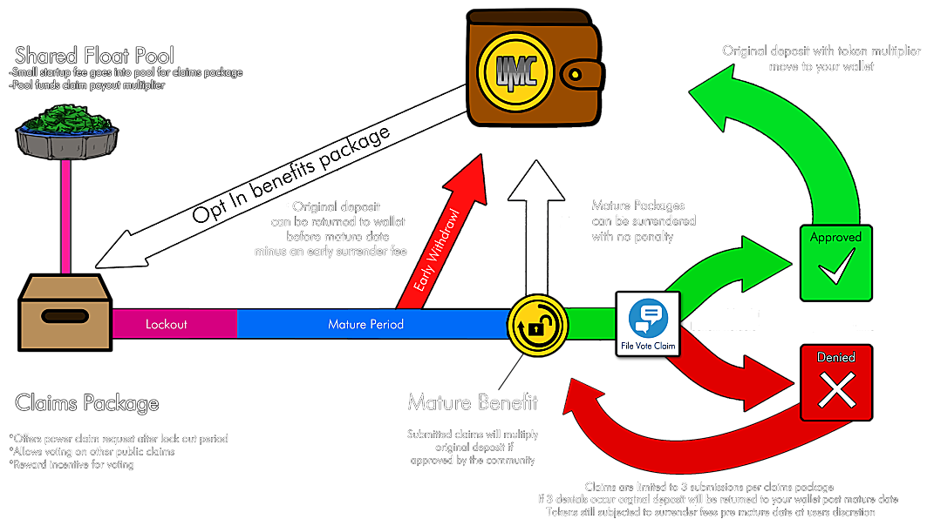

Slide 5
Technology Stack
Client built using Meteor (https://www.meteor.com/)
Full stack JavaScript solution suitable for desktop, mobile and tablet
Deployment provided by AWS
Interfaces with Ethereum via Web3 API (https://github.com/ethereum/web3.js/)
Built-in integration with MongoDB
Easy integration with React for UI and Node for server logic
Ethereum Blockchain
Core business logic where we need consensus (i.e. claims and payouts)
MongoDB
Data store for user creation and vote tracking (i.e. any non-critical business logic)

Slide 6
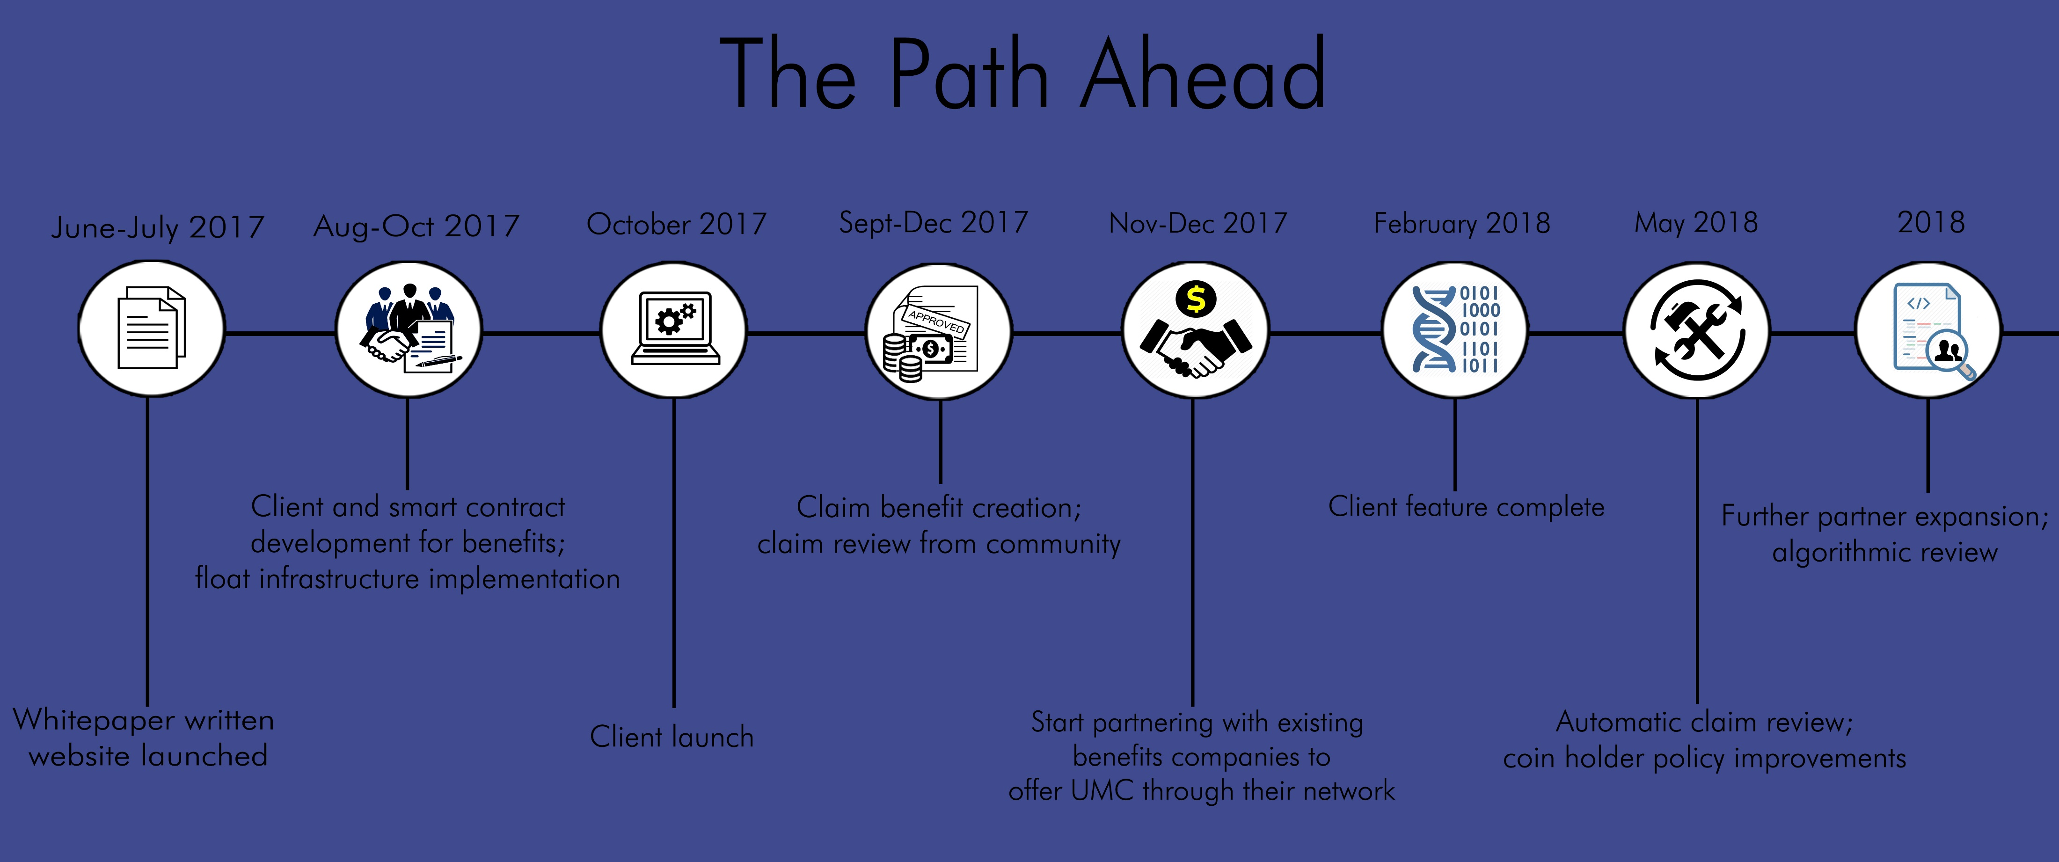

Slide 7
Crowdsale Details
Pre-Sale Start Date: 20 August 2017 12:00 UTC Pre-Sale End Date: 31 August 2017 12:00 UTC 30% bonus token distribution Goal: 2000 ETH
If this goal is met, we will immediately close the pre-sale, take those funds and focus on marketing the launch
Crowdsale Start Date: 20 September 2017 12:00 UTC Crowdsale End Date: 20 October 2017 12:00 UTC Issuance of UMC Tokens: 100,000,000 Tokens Exchange rate: 600 UMC = 1 ETH Minimum contribution: 60 UMC = 0.1 ETH Maximum contribution: 1,800,000 UMC = 3000 ETH Minimum sale goal: 5000 ETH Total sale goal: 100000 ETH Bounty: 1,200,000 Tokens (1.2% of issuance) Token distribution rules: 68.8% (68 million tokens) will be available to participants 20% (20 million tokens) will be used to build a preliminary float pool. 10% (10 million tokens) will be distributed among team members

Slide 8
Resources
https://www.umbrellacoin.org
http://staging.umbrellacoin.meteorapp.com
A very early alpha of the web client
Under development, so disruptions are common

